Slide 1
Principles of International Finance and Open Economy Macroeconomics
Cristina Terra

Slide 2
Chapter 10 Exchange Rate Regimes
Cristina Terra

Slide 3
Introduction
The exchange rate regime defines the government exchange rate policy rules.
Examples:
Fixed exchange rate regime: the government pledges to intervene in the market to prevent any exchange rate change
Floating exchange rate regime: the government declines to intervene, allowing the exchange rate to float according to the supply and demand of foreign currency
The exchange rate regime is intimately associated to the central bank monetary policy, as shown in the monetary models discussed in Chapter 6.

Slide 4
Introduction
Plan
Classification of exchange rate regimes
The economic implications for the different regimes
Which elements should be taken into consideration when choosing an exchange rate regime?

Slide 5
Introduction
Plan
Classification of exchange rate regimes
The economic implications for the different regimes
Which elements should be taken into consideration when choosing an exchange rate regime?

Slide 6
Classification of Exchange Rate Regimes
There is a large diversity of exchange rate regimes, which can be divided into three large groups
floating regimes,
flexible parity regimes and
fixed parity regimes.
Following is a classification of the exchange rate regimes, ordered from the most flexible to the most rigid

Slide 7
Floating Exchange Rate Regimes
Free Floating
No government intervention in the market, nor use of monetary policy with the objective of affecting the exchange rate
The exchange rate level is determined by the supply and demand of money, without.
Managed or Dirty Floating
the exchange rate is, in principle, floating, but the government can make timely interventions to avoid excessive or undesired variations in the exchange rate.

Slide 8
Soft Peg Regimes
Crawling Bands
exchange rate floats within announced limit and the government intervenes to prevent it from crossing the floating band barriers.
Two types
horizontal band: the exchange rate floats around a fixed parity. Example: European exchange rate mechanism in the 1980s and 1990s.
adjustable band: the parity follows a tendency, which can be either appreciation or depreciation. Extensively used by countries with high inflation
Crawling Pegs
the exchange rate is periodically adjusted according to a previously announced program.
Also used by high inflation countries –the programmed exchange rate adjustments served as nominal anchors in price stabilization programs.

Slide 9
Soft Peg Regimes
Fixed Exchange Rate
The government pledges to intervene in the exchange rate market and/or use interest rate policy to maintain the exchange rate fixed at a previously announced level.
Soft peg: no mechanism to provide strong government commitment to maintain the parity – all that is necessary to alter the parity is to announce it.
In the same way governments tend to not allow floating exchange rates to float, they also tend to readjust an announced fixed exchange rate regime.

Slide 10
Hard Peg Regimes
Currency Board
Legal obligation to maintain a given exchange rate parity.
The central bank should back the monetary base with the foreign currency, such that all home currency should be able to be converted into the foreign currency at the parity.
the central bank has no control over the money supply and cannot be a lender of last resort to banks.
Example: Argentina in the 1990s.
Dollarization
Unilateral adoption the currency of another country.
The country that issues the original currency continues to have sovereignty over its emission and the monetary policy to be followed.
Examples: Panama and Ecuador.

Slide 11
Hard Peg Regimes
Monetary Union
The members of a monetary union share the same currency and manage it by means of a common accord.
The International Monetary Fund (IMF) classifies the exchange rate regime of countries in a monetary union according to the regime adopted for the common currency.
For example, each country in the Eurozone is classified as following a floating exchange rate regime for they adopted the euro, and the euro is free floating.

Slide 12
De Jure Vs. De Facto Classifications
IMF de jure classification exchange rate regimes
Regime officially communicated to the IMF by the countries, registered in the Annual Report on Exchange Arrangements and Exchange Restrictions.
Problem: countries do not always follow what they annouce
IMF de facto classification of exchange rate regimes
Since 1998, classification based on the exchange rate policy effectively implemented by countries.
Regimes are ordered based on the degree of exchange rate flexibility and whether there is a commitment with respect to its trajectory.
This classification system also presents the monetary policy followed, providing a clear connection to the currency exchange rate

Slide 13
Dual or Multiple Exchange Rate Markets
Dual exchange rate: may be official or unofficial, (the latter being the parallel exchange rate, or the `black market’).
Multiple exchange rate markets: different exchange rates for different types of transactions.
Typically, the government establishes exchange rate parity for commercial transactions, while it allows the exchange rate to float for financial transactions.
Example: Latin American countries during foreign debt crisis in the 1980s.
The government then guaranteed a cheap dollar for the import of ‘essential’ products.
When there are two exchange rates employed, one being fixed and the other floating, the floating should be used to identify the exchange rate regime.

Slide 14
Alternative ER Regime Classifications
Four exchange rate de facto regime classification proposals that seek to identify the exchange rate regime that is in fact implemented by each country.
IMF
Shambaugh
Levy-Yeyati and Sturzenegger
Reinhart and Rogoff
Problem: is not always a consensus between these classifications.

Slide 15
Introduction
Plan
Classification of exchange rate regimes
The economic implications for the different regimes
Which elements should be taken into consideration when choosing an exchange rate regime?

Slide 16
Plan: Economic Implications
Plan
Fixed vs. Flexible Exchange Rate
Optimum Currency Area
Inflation and Exchange Rate Anchoring
Exchange Rate Regime and Financial Dollarization
Exchange Rate Regime, Sovereign Debt and Crises

Slide 17
Plan: Economic Implications
Plan
Fixed vs. Flexible Exchange Rate
Optimum Currency Area
Inflation and Exchange Rate Anchoring
Exchange Rate Regime and Financial Dollarization
Exchange Rate Regime, Sovereign Debt and Crises

Slide 18
Which Exchange Rate Regime to choose? Fixed vs. Flexible Exchange Rate
Classic discussion: fixed exchange rate or floating.
To compare the regimes, we consider the impact of real shocks (such as terms of trade, fiscal policy or technology shocks) and nominal shocks (such as money demand or government monetary policy) on the output, balance of payments and the real exchange rate in each of these two regimes.
Analytical framework: sticky price models described in Ch. 7.
Main result: the economy is better protected from real shocks with a floating exchange rate regime, while a fixed regime is a better alternative in the case of nominal shocks.

Slide 19
Fixed vs. Flexible Exchange Rate: Real Shocks
Real shocks (ex.: terms of trade deterioration)
A real shock alters the equilibrium RER.
Floating exchange rate: the nominal exchange rate can immediately jump to the level that leads the RER to its new equilibrium level.
Fixed exchange rate: adjustment would be through prices changes, which takes time. The RER would be out of its equilibrium level during the price adjustment period.

Slide 20
Fixed vs. Flexible Exchange Rate: Nominal Shocks
Nominal shock (ex.: financial innovation reduces money demand)
Lower demand for domestic currency => excess demand for foreign currency and pressure for exchange rate depreciation.
Flexible exchange rate: exchange rate depreciation => RER depreciation (sticky prices) => CA balance greater than its optimal level
Fixed exchange rate: government sells its its international reserves to the excess demand for foreign currency => domestic money supply decreases, rebalancing the market. No changes in interest or relative prices, hence no effect on the real side of the economy.

Slide 21
Fixed vs. Flexible Exchange Rate
In sum:
countries exposed to real shocks should opt for a floating exchange rate regime, while
countries subject to monetary and financial uncertainties should follow a fixed exchange rate regime.
International mobility of capital => vulnerable to speculative attacks when maintaining exchange rate parity
ER parity only possible in a hard peg regime (currency board, dollarization and monetary union) => greater commitment.
Fundamental characteristic of these regimes: the cost to abandon them is higher.

Slide 22
Trade Openness and Exchange Rate Policy
McKinnon (1963): three government objectives:
Maintain full employment.
Maintain external balance.
Maintain price stability.

Slide 23
Trade Openness and Exchange Rate Policy
Two types of policies to handle balance of payments problems
Expenditure switching policies: they act directly on relative prices, affecting the relative supply and demand between sectors. Ex.: exchange rate variation, which affects tradables/non-tradables prices
expenditures reducing policies: they reduce aggregate demand. Ex.: contractionist fiscal policy.
Lower aggregate demand => lower demand for tradable goods => higher trade balance.

Slide 24
Expenditure Switching vs. Expenditure Reducing Policies
Undesirable side effects:
Exchange depreciation => inflationary pressure
The greater the relative size of the tradable sector in the economy, greater will be the inflationary pressure caused by exchange rate depreciation.
Contractionist fiscal policy => lower demand for all goods in the economy => can lead to recession.
The smaller the relative size of the tradable goods sector, the greater the recession due to the use of fiscal policy to balance the balance of payments.

Slide 25
Exchange Rate Depreciation and Openness
With differentiated goods: exchange rate depreciation => domestic goods relatively less expensive => higher exports and lower imports.
In this case, the more open an economy, the greater impact exchange rate depreciation will have on the balance of payments.
Hence:
On the one hand, a greater openness increases the pass-through from exchange rate to inflation,
On the other hand, the exchange rate depreciation necessary for external equilibrium is lower in a more open economy.
The relation between inflation and trade openness when the exchange rate is used to balance the balance of payments is, in principle ambiguous.

Slide 26
Plan: Economic Implications
Plan
Fixed vs. Flexible Exchange Rate
Optimum Currency Area
Inflation and Exchange Rate Anchoring
Exchange Rate Regime and Financial Dollarization
Exchange Rate Regime, Sovereign Debt and Crises

Slide 27
Monetary Union
Monetary union:
A group of countries adopts a common currency
A common central bank is created
Decision-making rules are established in such a way as to attend the needs of each member of the union.

Slide 28
Optimum Currency Area
Common currency = same monetary policy.
Question: does the benefit generated in having a common currency supersede the cost of also following a common monetary policy?
Mundell (1961) defines the characteristics that should be shared by countries that adopt a common currency.
Example to illustrate the problem.
Two countries: Germany and France
Two goods:
Camembert cheese, produced in France
Mercedes Benz automobiles, produced in Germany

Slide 29
Example
Initially: full employment and equilibrium in the balance of payments
Shock: demand shift from Camembert cheese to Mercedes Benz automobiles
Short-run:
unemployment in France and inflationary pressure in Germany
trade deficit in France and a trade surplus in Germany.
How does the adjustment occur in these two economies?

Slide 30
Adjustment
In a currency union, there are, essentially, two paths for adjustment:
Inflation in Germany = change in the terms of trade: the Mercedes becomes relatively more expensive => raises demand for Camembert.
Full employment is reestablished in France, while the fall in demand for Mercedes ends the inflationary pressure in Germany.
Deflation in France = Camembert price falls, altering the relative price and leading to a new equilibrium, as in the mechanism described before.

Slide 31
Adjustment
Prices, however, are not perfectly flexible, and they are particularly rigid to the fall.
Typically, prices only fall at the cost of recession and unemployment.
Central banks, on the other hand, oppose price increases with restrictive monetary policies.
With different currencies, a change in the exchange rate between the two currencies would alter the relative prices, leading to prompt equilibrium in the balance of payments with no transition costs.

Slide 32
Real Shock
One of the criteria to determine if a group of countries constitutes an optimum currency area: correlation of real shocks
Real correlated shocks => the countries suffer, in general, the same shocks of supply and demand for goods.
In the example: France and Germany would have real correlated shocks if whenever there was an increase in demand for Mercedes, there would also be an increase in demand for Camembert.
The lower the correlation between the real shocks in the economies, the lesser the chance they constitute an optimum currency area.

Slide 33
Real Shock
It is important to note that the same argument applies to the different regions within the same country.
Not always does a country constitute an optimum currency area.
If the regions of a country produce distinct goods, subject to real idiosyncratic shocks, theoretically a greater welfare could be reached if each region had its own currency, with a flexible exchange rate between them.
The next example illustrates this situation.

Slide 34
Example: Different Regions
Consider:
Two countries: Canada and the United States
Two regions in each country: East and West
Two goods, automobiles and lumber.
Production factors are not mobile between countries or regions
Production:
East regions = cars
West regions = lumber

Slide 35
Example: Different Regions
Initially: full employment and equilibrium in the balance of payments
Shock: increase in productivity in the automotive sector, which affects each country equally
Short-run: excess supply of automobiles.
Excess supply of automobiles = excess demand for lumber
unemployment in the east and inflationary pressure in the west in both countries.
New equilibrium: fall in the relative price of automobiles.
A change in the exchange rate between the two countries would not help

Slide 36
Adjustment
If production factors were mobile between regions, a migration of factors from east to west would lead to equilibrium in the economy.
Therefore, another important factor in determining the convenience of a single currency is the degree of production factor mobility between regions.
That is why one of the policies adopted by the European Monetary Union was the ease of mobility of goods and production factors.

Slide 37
Monetary Union and Trade
Strong argument pro-monetary union: lower cost of trade, with single currency
The exchange rate risk disappears when countries use the same currency.
Therefore, the greater the trade between countries, the greater the benefit of sharing the same currency.
Empirical evidence: participation in monetary unions has a positive impact on trade between its members
Rose and Stanley (2005): monetary union can increase trade somewhere between 30% and 90%
Micco and Ordoñez (2003) and Nardis and Vicarelli (2008): more modest estimates – between 4% and 10%.

Slide 38
Monetary Union and Public Finance
As we saw in Chapter 7, fiscal expansion leads to an increase in the money supply in a fixed exchange rate regime.
To maintain an austere monetary policy, it is necessary that the monetary union member countries follow equally austere fiscal policies.
Stability and Growth Pact of the European Monetary Union: monitoring and guaranteeing the fiscal stability of union member countries

Slide 39
Monetary Union and Public Finance
Another element: the inflation tax generated, and countries may diverge as to their preferred inflation tax level.
In countries where the distortion from taxes on goods, labor and capital is too high, the optimal tax on currency will be relatively greater.
Example: Italy and Germany
Italy: large informal sector. A means to tax this sector is with an inflation tax.
Germany, however, does not have this problem.
the optimum inflation tax for Germany will be lower than that for Italy.
The higher the public spending, the less likely the optimum inflation rate will be the same between countries.

Slide 40
the Trade-off between Inflation and Unemployment
Sensitive issue: to use, or not, an active monetary policy to soften negative shocks to the economy?
With sticky prices, monetary expansion can increase output in the short run, before prices have time to adjust (Chapter 7).
Side effect: its effect on inflation.
trade-off between inflation and unemployment.

Slide 41
the Trade-off between Inflation and Unemployment
Credibility issue: governments would like to commit themselves to maintain low inflation, but if the economic agents expect low inflation, governments have an incentive to generate surprise inflation to stimulate economic activity.
Given that economic agents foresee this government motivation, they already expect a higher inflation rate.
In the end, there is positive inflation, however with no stimulus to the economy since it is perfectly anticipated.

Slide 42
Central Bank Independence
Central bank independence is one way to tackle this problem, as suggested by Rogoff (1985).
Independent central bank with strong preference for low inflation = immune to government pressure to inflate => expectation of low inflation => the result would be a low equilibrium inflation rate.
Example: the German central bank, which signaled a strong preference for low inflation as a mechanism to control expectations, before the introduction of the monetary union.
What happens when an independent central bank is common in monetary union member countries? Next…

Slide 43
Government Preferences
Government preferences are represented by a loss function that considers the losses associated with inflation and unemployment.
Preferred government inflation = 0
Preferred unemployment = lower than the natural rate of unemployment
One explanation: due to imperfections in the goods market (monopolies or regulations), the natural unemployment rate is greater than optimal
$$L_{i}={\left(u−{\overline{u}}_{i}\right)}^{2}+θ_{i}π^{2}$$
${\overline{u}}_{i}$: unemployment desired by the government.

Slide 44
Unemployment rate
Unemployment, in turn, is given by:
$$u={\tilde{u}}_{i}+ε_{i}−\left(π−π^{e}\right)$$
${\tilde{u}}_{i}$: the natural rate of unemployment
Assumption: ${\tilde{u}}_{i}−{\overline{u}}_{i}=k_{i}>0$
$ε_{i}$: random shocks on unemployment, with $E\left[ε_{i}\right]=0$
$π^{e}$: expected inflation, and $\left(π−π^{e}\right)$ is the surprise inflation.
Last term: surprise inflation can reduce the unemployment.
Why? Wages are predetermined (contracts). Higher prices = lower real wage => Llbor becomes relatively cheaper => higher demand for labor => higher production and lower unemployment.

Slide 45
Optimal Inflation
Substituting the unemployment equation into the government loss function, we get:
$$L_{i}={\left[k_{i}+ε_{i}−\left(π−π^{e}\right)\right]}^{2}+θ_{i}π^{2}$$
Inflation is chosen so as to maximize its loss function above, taking as a given the inflation expected by private agents, $π^{e}$.
Optimal inflation:
$$π_{i}=\frac{k_{i}+ε_{i}+π^{e}}{1+θ_{i}}.$$

Slide 46
Expected Inflation
What would be the inflation rate expected by the public?
Under rational expectations, we have that:
$$π_{i}^{e}=E\left[\frac{k_{i}+ε_{i}+π_{p}^{e}}{1+θ_{i}}\right]=\frac{k_{i}+π_{i}^{e}}{1+θ_{i}},$$
Solving the equation above, we get:
$$π_{i}^{e}=\frac{k_{i}}{θ_{i}}$$

Slide 47
Equilibrium Inflation
We can then find the equilibrium inflation rate:
$$π_{i}=\frac{k_{i}}{θ_{i}}+\frac{ε_{i}}{1+θ_{i}}$$
First term, $\frac{k_{i}}{θ_{i}}:$ the government attempt to cause surprise inflation to reduce the average unemployment.
However, it is already expected by the public and causes no surprise at all => no effect on unemployment: “inefficient” part of inflation.
The greater the weight given to inflation, $θ$, the smaller this term will be = the less government likes inflation, the lower average inflation will be
Rogoff (1985): independent central bank be independent, with a president with a high $θ$. Inflation in the economy would then be :
$$π_{bc}=\frac{k_{i}}{θ_{bc}}+\frac{ε_{i}}{1+θ_{bc}}.$$

Slide 48
Independent Central Bank
Second term, $\frac{ε_{i}}{1+θ_{bc}}:$ the inflation generated in response to unemployment shocks
Since these shocks are unexpected, this parcel of inflation is also unexpected, reason for which it can achieve its objective.
Cost form having a central bank president who does not like inflation: (s)he uses monetary policy less to counter shocks.
On average, the inflation chosen by the central bank is lower $\left(\frac{k_{i}}{θ_{bc}}<\frac{k_{i}}{θ_{i}}\right)$, but the smoothing of shocks is also lower $\left(\frac{ε_{i}}{1+θ_{bc}}<\frac{ε_{i}}{1+θ_{i}}\right)$.

Slide 49
Central bank and Monetary Union
So, what happens when there is a monetary union (MU)?
Unemployment shocks, $ε$, and excessive unemployment, $k$, are taken as an average of the union members.
The preference in relation to inflation, $Θ$, is that of the central bank president.
Inflation is:
$$π_{um}=\frac{k}{Θ}+\frac{ε}{1+Θ}$$

Slide 50
Monetary Union of not?
Comparing the expected for a member of a MU, to its loss if it had its own currency.
When it is a member of a MU:
$$E\left[L_{i}^{mem}\right]=E\left[{\left(k_{i}+ε_{i}−\frac{η}{1+Θ}\right)}^{2}+θ_{i}{\left(\frac{k}{Θ}+\frac{η}{1+Θ}\right)}^{2}\right]$$
If the country were autonomous, the loss function would be:
$$E\left[L_{i}^{aut}\right]=E\left[{\left(k_{i}+\frac{θ_{bc}}{1+θ_{bc}}ε_{i}\right)}^{2}+Θ_{i}{\left(\frac{k_{i}}{θ_{bc}}+\frac{ε_{i}}{1+θ_{bc}}\right)}^{2}\right]$$

Slide 51
Monetary Union of not?
The difference between the two:
$$EL_{i}^{mem}−EL_{i}^{aut}=θ_{i}\left[{\left(\frac{k}{Θ}\right)}^{2}−{\left(\frac{k_{i}}{θ_{bc}}\right)}^{2}\right]+\frac{1+2θ_{bc}θ_{p}}{{\left(1+θ_{bc}\right)}^{2}}σ_{ε}^{2}+\frac{1+θ_{i}}{{\left(1+Θ\right)}^{2}}σ_{η}^{2}−\frac{2}{1+Θ}σ_{εn}$$
$σ_{ε}^{2}$ and $σ_{η}^{2}$ : variance of domestic shocks $ε_{i}$ and aggregate shocks, $η$
$σ_{εn}$: covariance between the two shocks
Two sources for the difference between $EL_{i}^{mem} and EL_{i}^{aut}$.
“Inefficient” portion of inflation: Ideally, this parcel should be zero. If $k<k_{i}$ and/or ${Θ>θ}_{i}$ => this inefficient portion of inflation will be smaller in the MU, and $θ_{i}\left[{\left(\frac{k}{Θ}\right)}^{2}−{\left(\frac{k_{i}}{θ_{bc}}\right)}^{2}\right]<0$

Slide 52
Monetary Union of not?
Unemployment shocks to which inflation responds (three last terms):
Greater $σ_{ε}^{2}$ => greater the relative loss in being a MU member (the common monetary policy does not respond to them).
It does respond to common shocks, $η$, which is not desirable for the country => high variance of common shocks, $σ_{η}^{2}$ = higher cost in participating in the MU
When the shocks are correlated, the MU policy will respond, in part, to the stability desire of the country => greater the covariance between shocks, $σ_{εn}$ = smaller the relative loss for participating in the MU.
In sum, countries with more homogeneous objectives and that are subject to more correlated real shocks will have their objectives better met in a MU

Slide 53
Monetary Union of not?
Summarizing:
More trade = more transaction costs when there is more than one currency. Also, MU raises trade between its members.
Countries that suffer similar real shocks are the most indicated to form an optimum currency area.
More flexible prices and wages => easier to make adjustments without exchange rate variations => less costly to give up the exchange rate as an adjustment variable.
The greater the mobility of production factors, the smaller the need for exchange rate variation to face real shocks.
MU sustainability will more certain if there is a definite leader, or an institutional framework that guarantees that the loss of monetary autonomy will be compensated for by other gains in cooperation.

Slide 54
Plan: Economic Implications
Plan
Fixed vs. Flexible Exchange Rate
Optimum Currency Area
Inflation and Exchange Rate Anchoring
Exchange Rate Regime and Financial Dollarization
Exchange Rate Regime, Sovereign Debt and Crises

Slide 55
Precommitment problem
Problems with intertemporal monetary policy inconsistencies are many times the root of chronic inflation.
As discussed before, with the objective of stimulating the economy, the government has an incentive to cause inflation when inflation expectations are low. Result: chronic inflation that is unable to raise outpu.
It would be preferable if government could commit to not concede to this temptation in a way that was credible to the public.

Slide 56
Precommitment Inflation and Exchange Rate
In an open economy, domestic prices cannot diverge from international prices when measured in the same currency. From PPP , we have that:
$$\dot{s}=π_{t}−π_{t}^{∗}$$
Fixed exchange rate regime => domestic inflation should be equal to that of the country to which parity was established.
One way of committing to a lower inflation rate, therefore, is to peg the currency to that of a country with low inflation: exchange rate anchor

Slide 57
Exchange Rate: Nominal Anchor
Advantage of exchange rate as an anchor: visible and easily verifiable instrument, therefore efficient as a sign of the government commitment to low inflation rates.
Disadvantage: the government loses it monetary policy autonomy.
It would be desirable to use monetary policy to soften temporary shocks to the economy.

Slide 58
Exchange Rate: Nominal Anchor
Important: the policy only works if the government effectively follows a monetary policy compatible with the fixed exchange rate.
Otherwise, it is prone to speculative attacks
In general, the experience showed that fixed rate regimes produced overvalued real exchange rates, be it due to residual inflation or to external shocks.
Result: trade balance deterioration

Slide 59
Case Study: The Currency Board Regime in Argentina
Argentina tried to solve its recurrent problem with high inflation by adopting a currency board regime, which demands a greater commitment to exchange rate parity.
Adjustment mechanism to an external shock that balance of payments deficit:
the government must sell reserves to cover the balance of payments deficit => monetary contraction.
In theory, monetary contraction => reduction in domestic prices => domestic goods more competitive => higher trade balance, rebalancing the balance of payments.

Slide 60
Case Study: The Currency Board Regime in Argentina
In practice, however, the solution is not that simple.
Workers rarely accept a reduction in their nominal wage and producers are reticent to permanently reduce the price of their products.
Hence, monetary contraction => recession, with little impact on prices.
This is what happened in Argentina: shocks led to trade deficits + credibility problems = hesitant investors => balance of payments growing deficits => monetary contraction.
Lack of liquidity was such that barter clubs began to proliferate around the country, where citizens traded goods among themselves.
Bonds issued by local governments began to be used as a means of payment.

Slide 61
Inflation Targeting: Nominal Anchor
Tendency in the 2000s: inflation targeting regime with an independent central bank + floating exchange rate
monetary austerity to maintain inflation under control, without the risk of external imbalances as those from a fixed exchange rate
Floating exchange = monetary policy autonomy
Inflation targeting = clear monetary policy to be followed, which objective should be the maintenance of inflation within a previously established band.

Slide 62
Exchange Rate: Nominal Anchor
The system requires, however, better quality institutions.
the government cannot use monetary policy for its own political goals, such as, for example, to stimulate economic activity before an election.
the central bank should develop technical abilities needed to refine its monetary policy to reach inflation targeting (data processing and econometric models to estimate the proper policy)
communication instruments should be created to allow its policies to be more transparent to the public, to ensure credibility and keep low inflation expectations
the central bank should build its credibility with the goal of more efficiently fighting inflation

Slide 63
Plan: Economic Implications
Plan
Fixed vs. Flexible Exchange Rate
Optimum Currency Area
Inflation and Exchange Rate Anchoring
Exchange Rate Regime and Financial Dollarization
Exchange Rate Regime, Sovereign Debt and Crises

Slide 64
Financial Dollarization
Financial Dollarization:
domestic investors purchase assets denominated in foreign currency and
domestic residents borrowing in foreign currency.
‘Dollarization’ since, in general, dollar that is the foreign currency

Slide 65
Financial Dollarization
At least three channels by which the adoption of a fixed exchange rate regime can incite financial dollarization:
Fixed exchange rate = lower exchange rate risk
No credible fixed exchange rate regime => the peso problem, as discussed in Chapter 3: domestic interest rate higher than foreign to maintain the attractiveness of domestic assets
Commitment to defend the exchange rate parity can be taken as an implicit government guarantee to save banks and domestic businesses that are indebted in foreign currency.

Slide 66
Financial Dollarization: Problem
Financial dollarization causes a mismatch of the monetary denomination of the assets and liabilities
Revenues in domestic currency and the debt in foreign currency => exchange rate depreciation increases the real cost of the debt
Consumption in domestic currency and savings in foreign currency => exchange rate appreciation reduces the purchasing power
Financial dollarization increases the exchange rate risk.

Slide 67
Exchange Parity and Financial Dollarization: The Argentine Case
Argentina currency board regime 1991-2001
1991-1998: 40% GDP growth
Argentine foreign debt increased substantially: government rose about 60%, the private sector grew 618%.
Series of foreign shocks by end 1990s => the abandon of the regime
High level of debt in dollars had an important role in the deep recession that followed the depreciation of the Argentine peso: in 2002, the real GDP was 28% lower than in 1998.

Slide 68
Plan: Economic Implications
Plan
Fixed vs. Flexible Exchange Rate
Optimum Currency Area
Inflation and Exchange Rate Anchoring
Exchange Rate Regime and Financial Dollarization
Exchange Rate Regime, Sovereign Debt and Crises

Slide 69
Exchange Rate Regime, Sovereign Debt and Crises
The exchange rate regime should be evaluated not only by the benefits it generates while it is in force, but also by its sustainability and the consequences when it cannot be maintained.
High private foreign debt => amplifying effect of crisis due to bankruptcies and financing problems caused by the exchange rate depreciation
High public foreign debt => exchange rate crisis causes deterioration in public finances => the government must increase its revenue to be able to meet the larger financial expenses.

Slide 70
Sovereign Debt
Payment of the sovereign foreign debt requires a double transfer of resources:
External transfer: trade surpluses must be generated to obtain foreign exchange for foreign creditor payments
Internal transfer: the government must raise resources by means of taxes to cover its financial expenses
The two transfers are connected by the exchange rate.
The exchange rate depreciation necessary for the foreign transfer increases the amount of internal transfer required to balance the government budget.

Slide 71
EUROPEAN DEBT CRISIS
European experience in the 2010s is a new version of the Latin American experience in the 1980s.
Eurozone countries are not perfectly homogenous in relation to their political economical institutions.
Two extreme examples:
Germany, with tight control of public finances and low inflation
Greece, where fiscal evasion and corruption are endemic problems and the country had high inflation rates before entering the Eurozone

Slide 72
Differences in Interest rates
Difference between the two countries is reflected in the interest rates they paid on their sovereign debt.
Beginning of the 1990s: over 20% for Greece and about 6% for Germany
Explaination: expectation of exchange rate depreciation, exchange rate risk and the difference in sovereign risk, as in:
$$i_{t}^{Gree}−i_{t}^{Germ}=\left[E\left(s_{t+1}\right)−s_{t}\right]+φ_{t}^{c}+φ_{t}^{s}$$
$φ_{t}^{c}$ = sovereign risk
$φ_{t}^{s}$ = exchange rate risk

Slide 73
Evolution of Interest Rates
Figure 10.1: evolution of interest rates on debt securities with a 10-year maturity
Interest rates migrated toward the German rates after the the euro.
Governments of countries such as Portugal, Spain and Italy, which historically paid a risk premium, began to pay less to borrow.
These countries benefitted from an implicit guarantee for their sovereign debt, borrowing from German credibility.

Slide 74
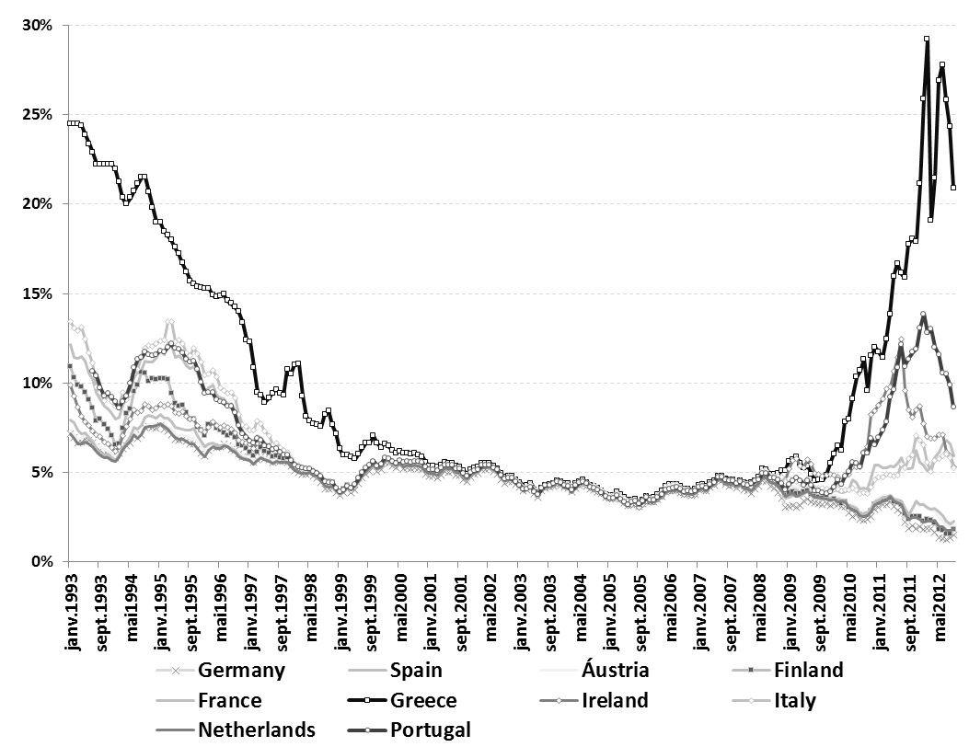
Figure 10.1: Evolution of Interest Rates in Europe

Slide 75
Indebtdness
Presented with lower interest rates, governments and private agents from these countries could borrow at a lower cost, which they promptly did.
Private credit increased in the European countries depicted in Figure 10.2, excepted for Germany.
Part of this increase in indebtedness came from external sources, accumulated through current account deficits.
Furthermore, a large part of the increased indebtedness was used to build real state, which does not increase future production capacity.

Slide 76
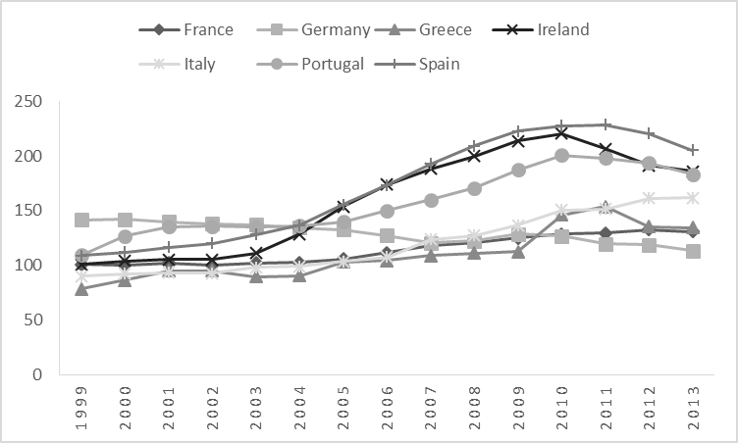
Figure 10.2: Private Credit Provided by Financial Sector (% of GDP)

Slide 77
Public Debt
Public debt: the Stability and Growth Pact was not able to guarantee the fiscal contention of countries in the region.
Complacency in relation to fiscal disequilibria in some cases, while in others reality was other than what the official statistics presented.
Greece and Italy, for instance, never met the debt/GDP ratio of 60% imposed by the pact.
Result: excessive foreign indebtedness of those countries that benefitted from lower interest rates upon joining the euro

Slide 78
2008 Crisis
2008 financial crisis: exposed the fragility of the situation.
Less credit => financing difficulty
Original European Union regulations prohibited the rescue of countries in crisis and the financing of their debt, without there being any alternative mechanisms to deal with the eventual sovereign insolvency of one of its members.

Slide 79
Europe vs. Latin America
One important difference between the European situation in the 2010 years and the Latin American in the 1980s:
European states debt was largely denominated in euros, their own currency, while the Latin American debt was denominated in foreign currency.
One solution: expansionist monetary policy => higher inflation + exchange rate deprecation => lower real value of the debt, sort of like a disguised default.
However, it did not help much in the European case since the countries in trouble did not have direct control over monetary policy, which is determined by the European Central Bank.

Slide 80
European debt Crisis: Does the Euro Survive?
The creditors for Greece, Spain and Portugal are, for the large part, financial institutions from other European countries, mainly France and Germany.
Whatever the solution, the Europeans are those who pay the bill.
Are the benefits of having the euro higher than the cost of bailing out the indebted countries?
(Here is another difference in relation to Latin American three decades ago: those countries were on their own.)

